Slide 1
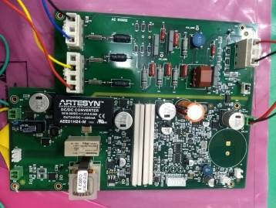
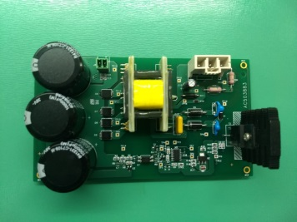
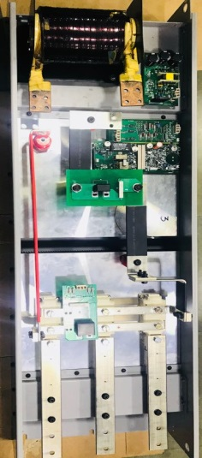
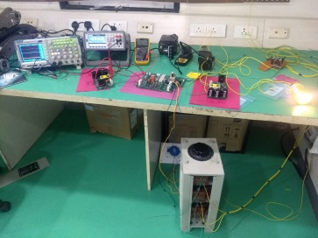
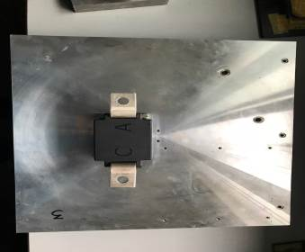
OVP Module Design
Achievements:
Unique Concept in Motor Protection Equipment
End to End product design from conceptualization to prototyping and design for manufacturing.
Thermal Analysis and identifying the Heat Sink Requirements and Semi-Conductor Junction Temperature observations/results
Prototypes manufacturing in India, Tested with Resistive / Inductive loads and samples shipped to Division for Integration testing.
Detailed Documentation provided.
Product Requirements Specification (PRS)
Hardware Design Document (HDD)
Tests Plans and Test Results Document (PCB & System Level)
Program | Design | Division
Project Schedule | 8 Months | Team Size | 4
Scope:
Design and Development of Over Voltage Protection Module (OVP) for High Speed PMSM Motor Test Rig. The scope of the project was complete product design including:
Concept Development
Power Circuit (600A /680VRMS)
SMPS based Power Supply Design
Control Circuit Design
Mechanical Enclosure
Thermal Analysis and Heat Sink Finalization
Tools/Techniques used:
MATLAB
Altium
Mentor Graphics Xpedition
Autodesk Inventor
Ansys
Application : Industrial Application

